Slide 1
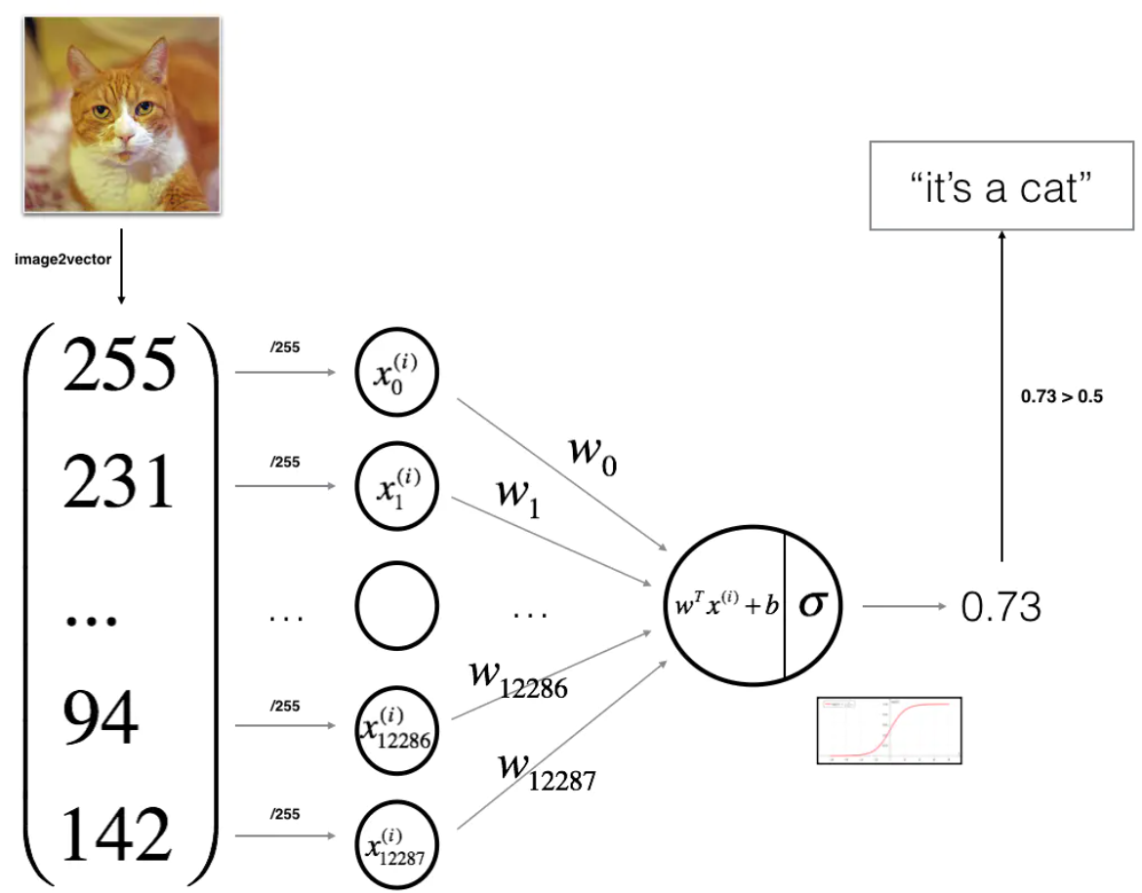

Slide 2
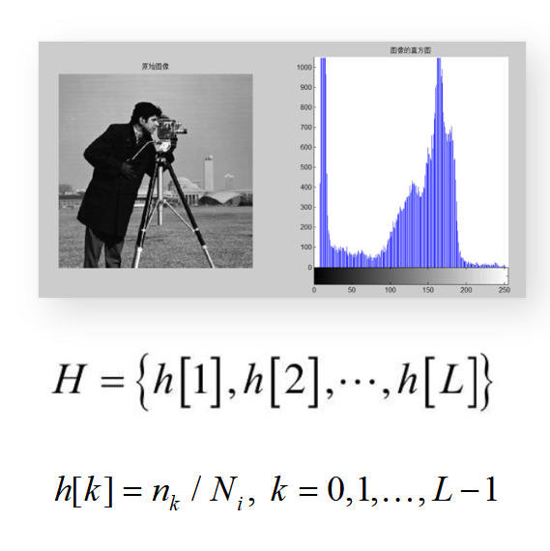

Slide 3
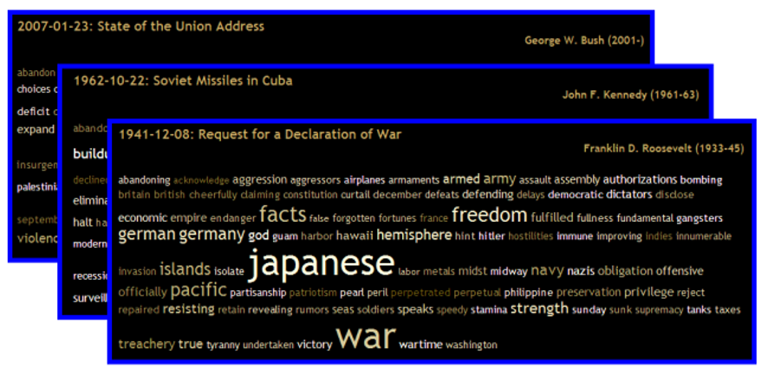
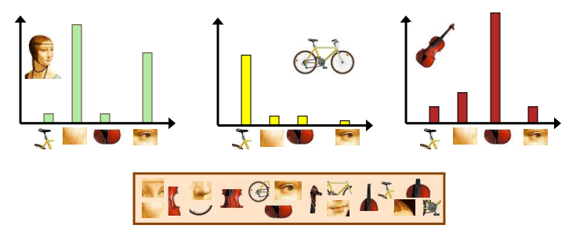

Slide 4
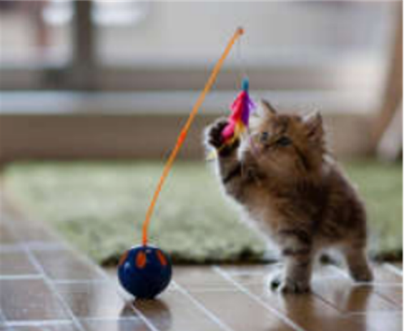
Top-1 Accuracy
Prediction 1: Cat Dog Car Chair
√
Prediction
Prediction 2: Dog Cat Car Chair
×

Slide 5
Top-5 Accuracy
Prediction 1: Cat Dog Car Chair
√
Prediction
Prediction 2: Dog Cat Car Chair
√

Slide 6
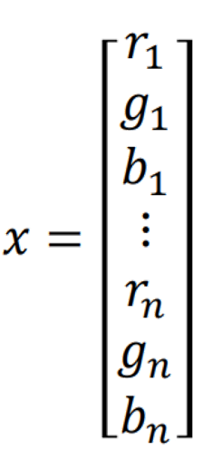
Matrix to vector
Image

Slide 7
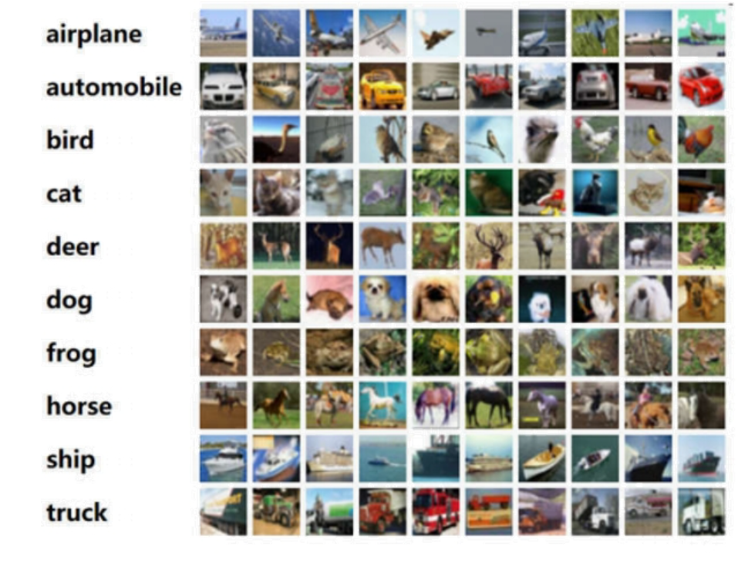
?

Slide 8
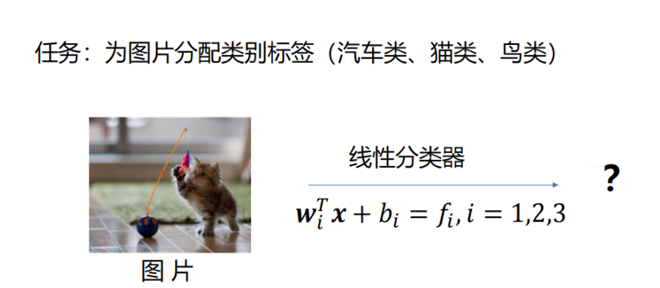
Task: Assign category labels to the image (car, cat, bird).
Linear Classifier
Image

Slide 9
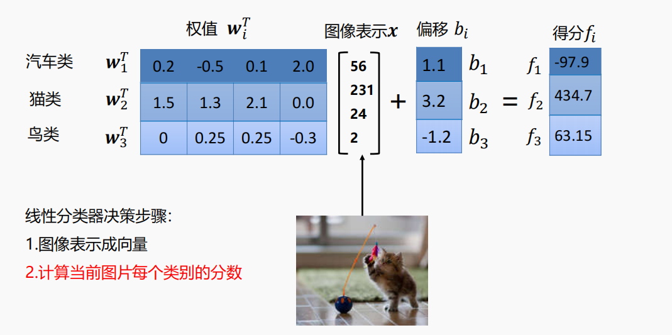
weights
image vector
bias
score
Car
Cat
Bird

Slide 10
weights
image vector
bias
score
Car
Cat
Bird
weights matrix
bias vector
score vector

Slide 11
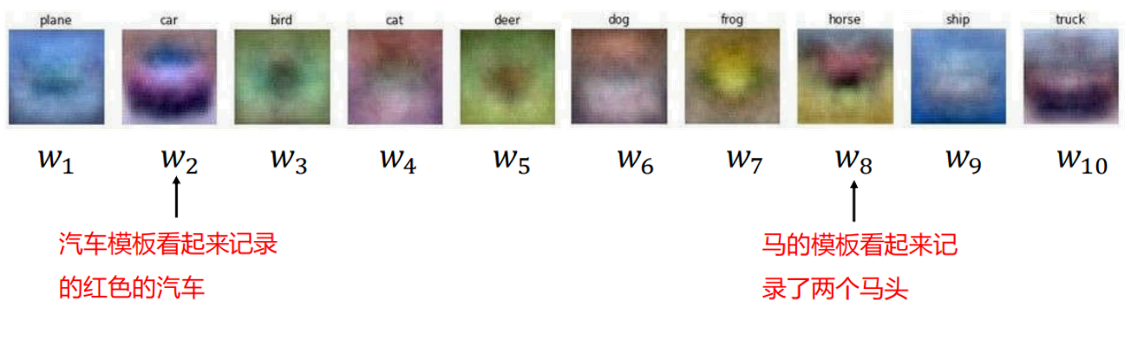
The car template looks like it records the red car.
The horse's template appears to record two horse heads.

Slide 12
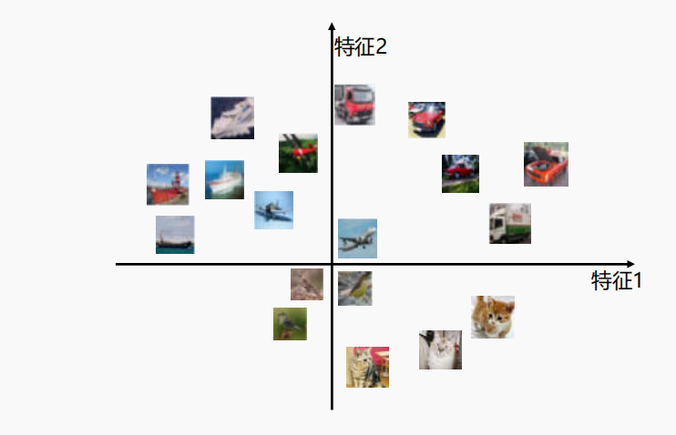
Feature 2
Feature 1

Slide 13
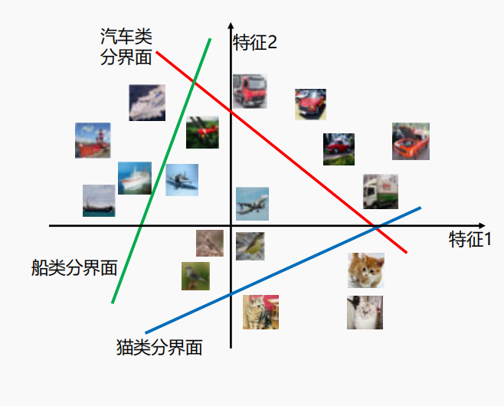
Decision Boundary for Cars
Feature 2
Decision Boundary for Ships
Feature 1
Decision Boundary for Cats

Slide 14
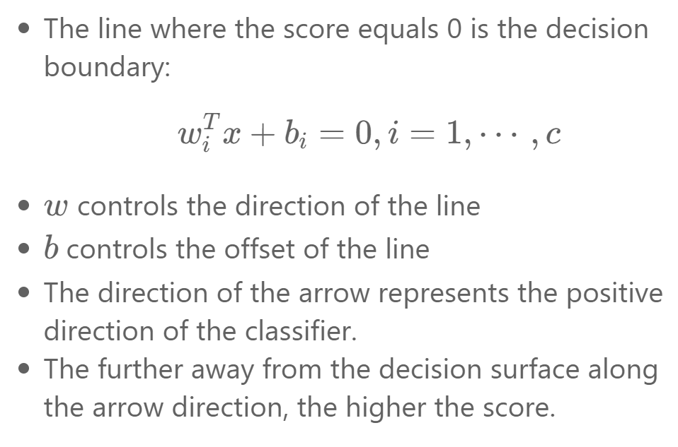
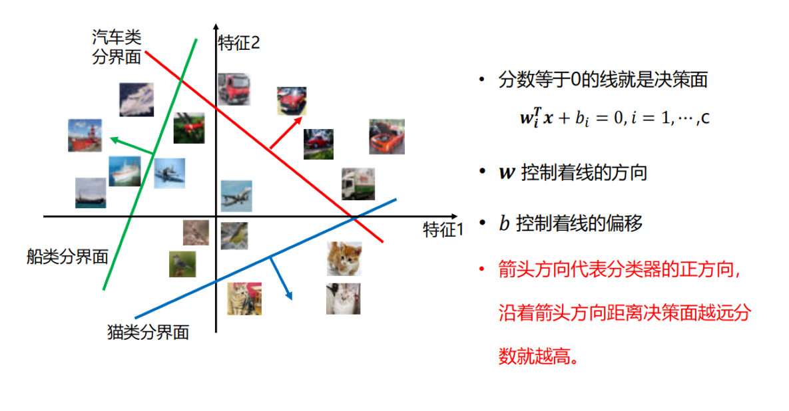
Decision Boundary for Cars
Feature 2
Feature 1
Decision Boundary for Ships
Decision Boundary for Cats

Slide 15
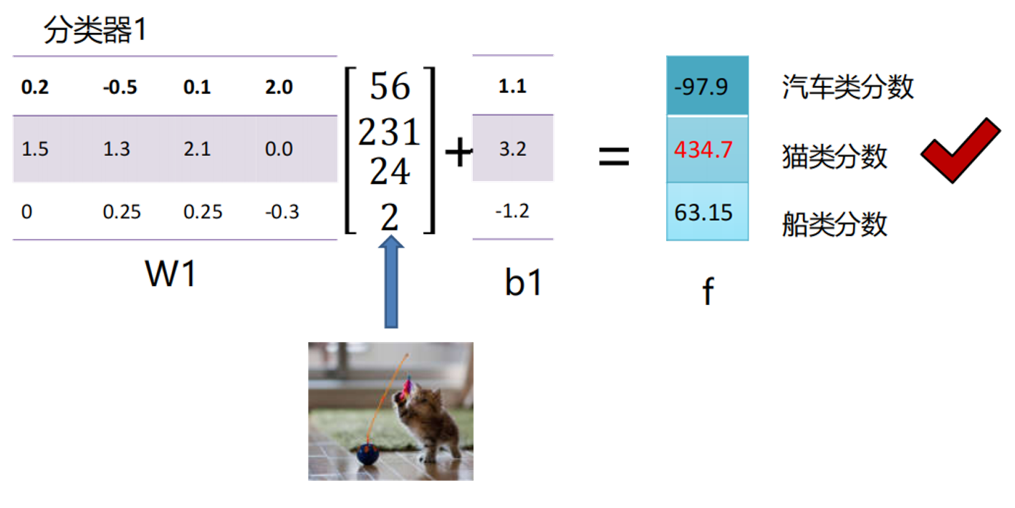
Classifier1
Score for car
Score for cat
Score for ship

Slide 16
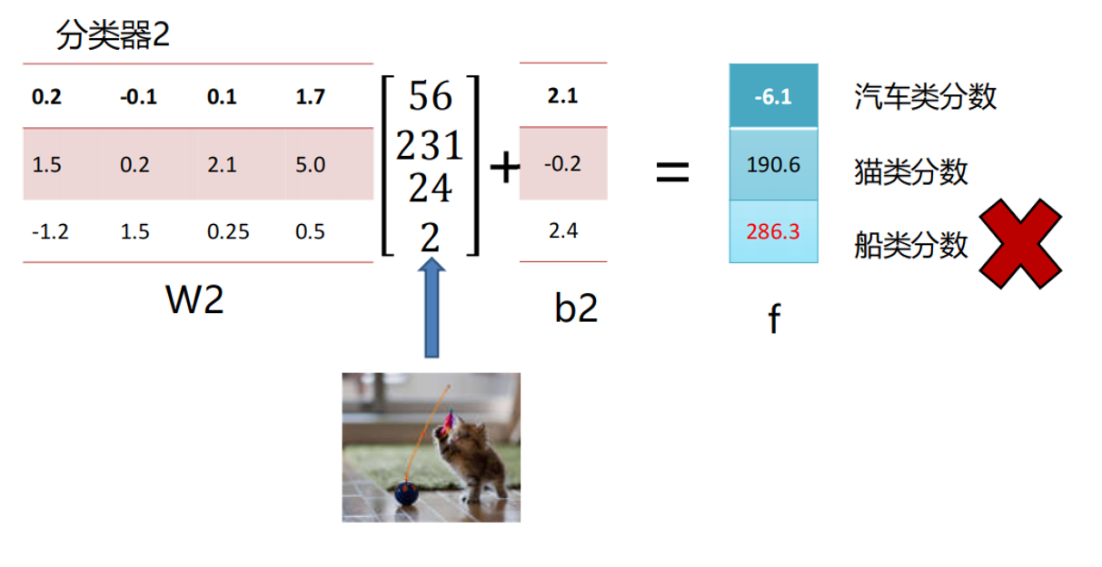
Classifier2
Score for car
Score for cat
Score for ship

Slide 17
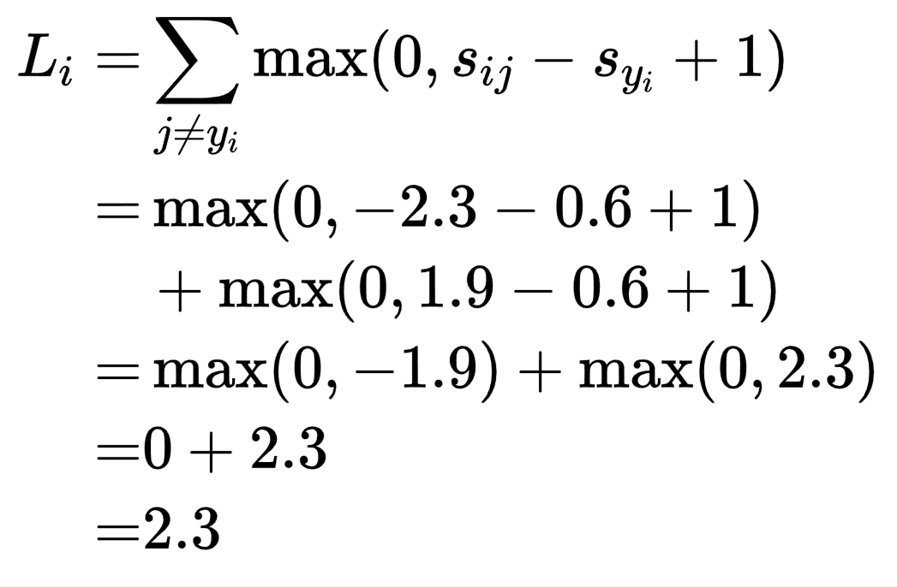
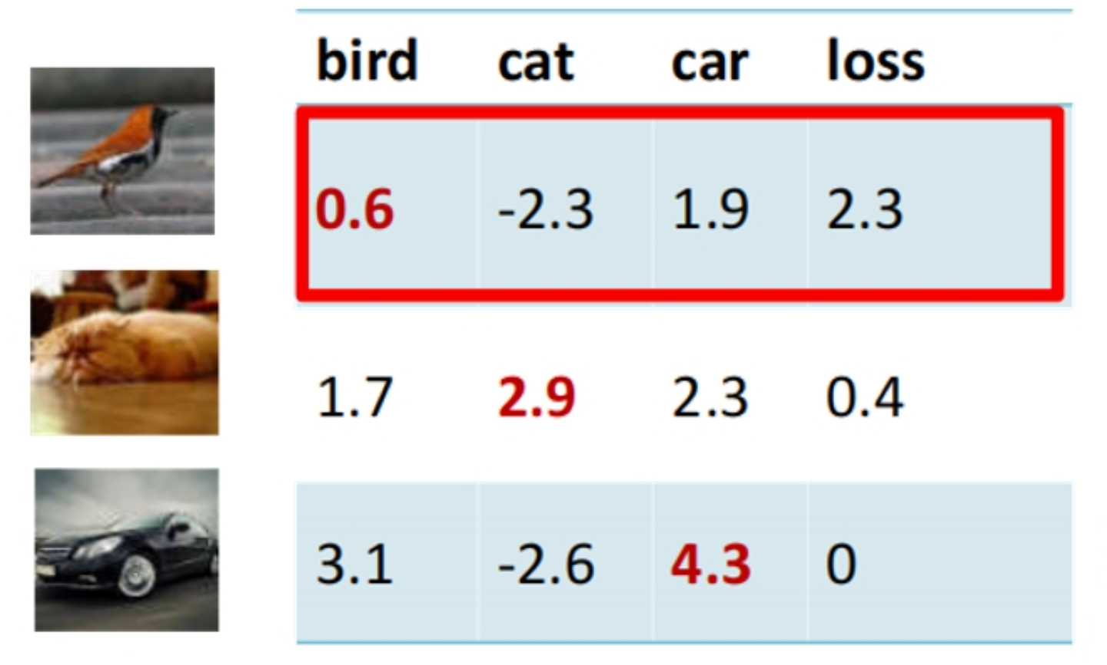

Slide 18
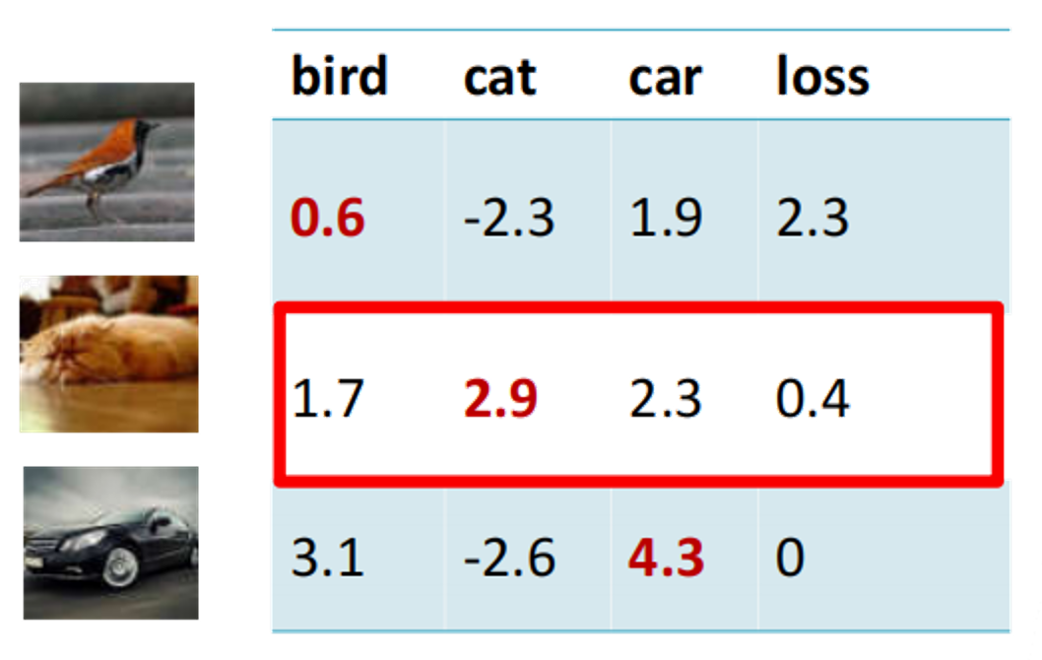
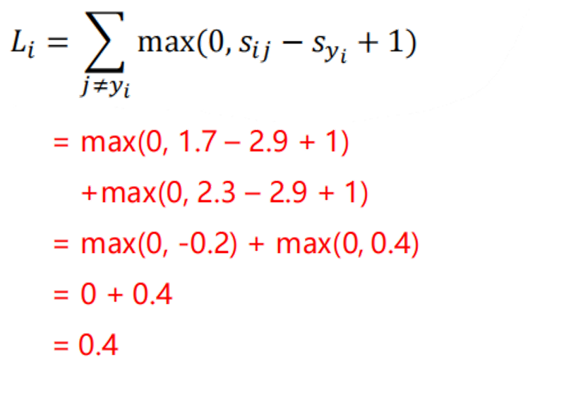

Slide 19
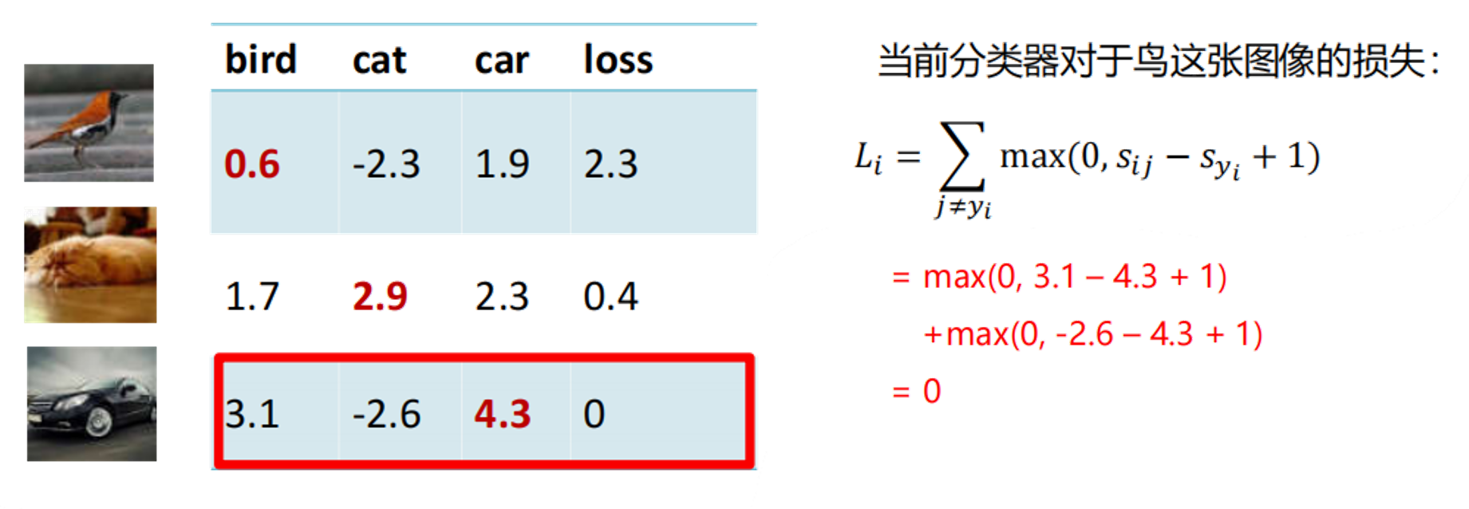

Slide 20
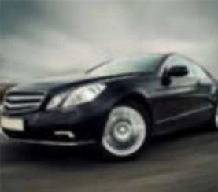
 | Bird | Cat | Car | Loss
Classifier1 | 3.1 | -2.6 | 4.3 | ?
Classifier2 | ? | ? | ? | ?

Slide 21
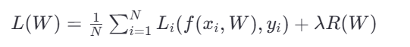
Data Loss: This part of the equation represents the model's prediction error on the training set. It measures how well the model fits the data.
Regularization Loss: This term prevents the model from overfitting to the training data by penalizing large weights.

Slide 22
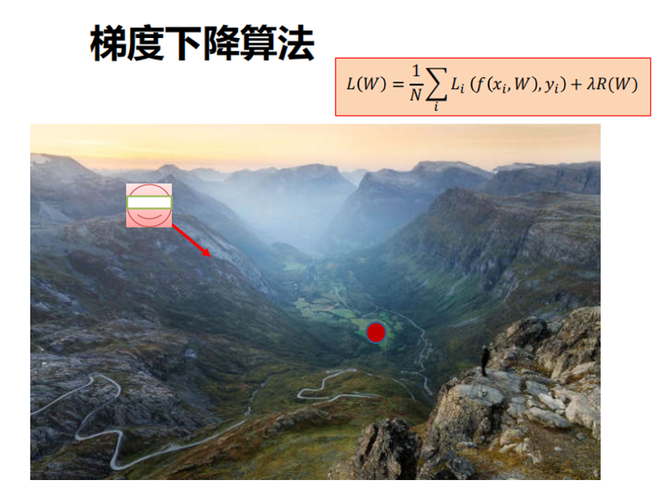
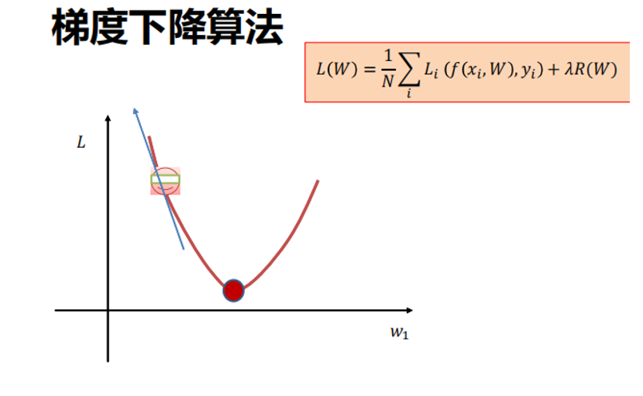

Slide 23
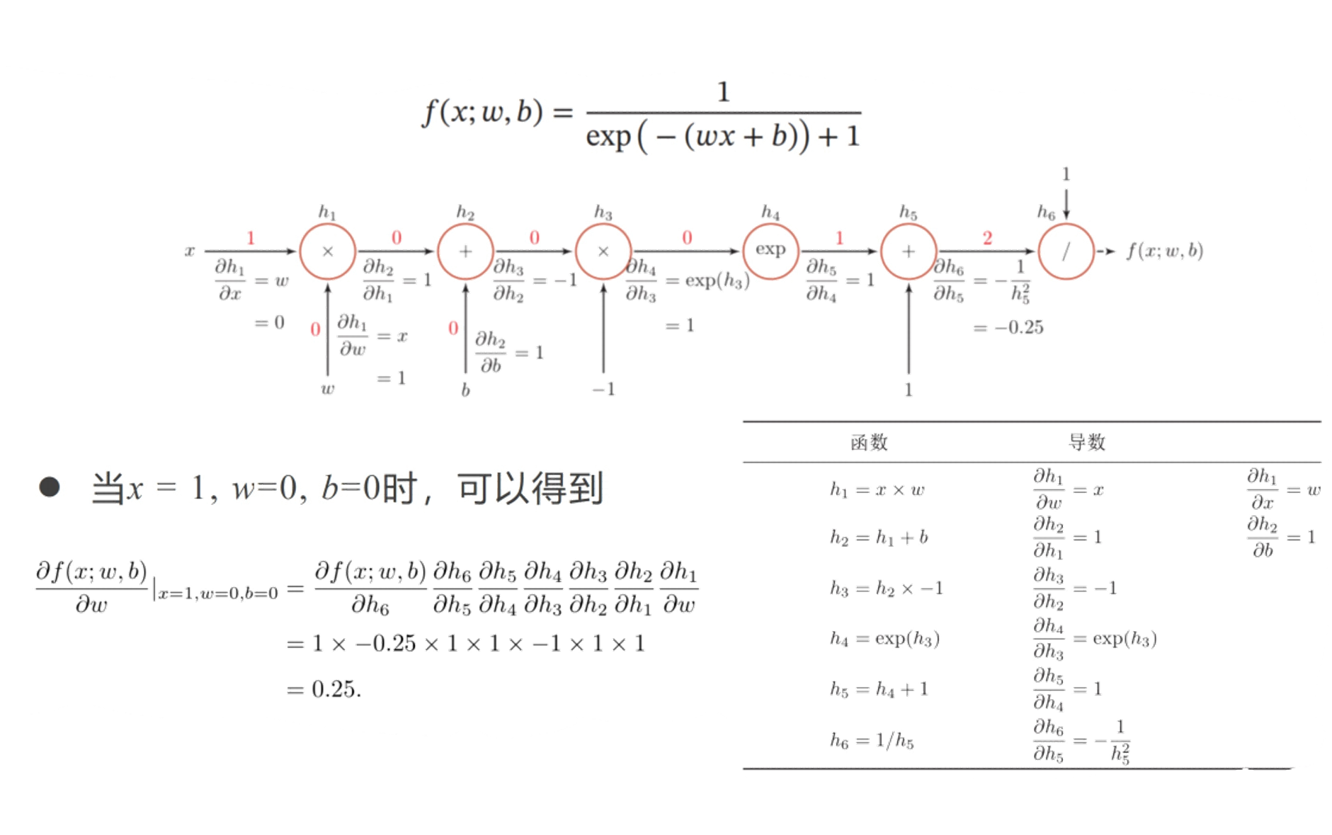
functions
derivatives
When x=1, w=0, b=0, we can get:

Slide 24
Dataset
Training set
Test set
Tune hyperparameters on the training set, and select hyperparameters on the test set.

Slide 25
All Labeled Data
Dataset
Training set
Validation set
Test set

Slide 26
3-Fold Validation
All samples not in the test set
Validation
Training
Training
Validation score for 1st fold
1st fold
Training
Validation
Training
Validation score for 2nd fold
Average of all validation scores
2nd fold
Training
Training
Validation
Validation score for 3rd fold
3rd fold

Slide 27
3-Fold Validation
All samples not in the test set
1st fold
Validation
Training
Training
Validation score for 1st fold
shuffled Data
2nd fold
Training
Validation
Training
Validation score for 2nd fold
Average of all validation scores
shuffled Data
3rd fold
Training
Training
Validation
Validation score for 3rd fold
shuffled Data

Slide 28
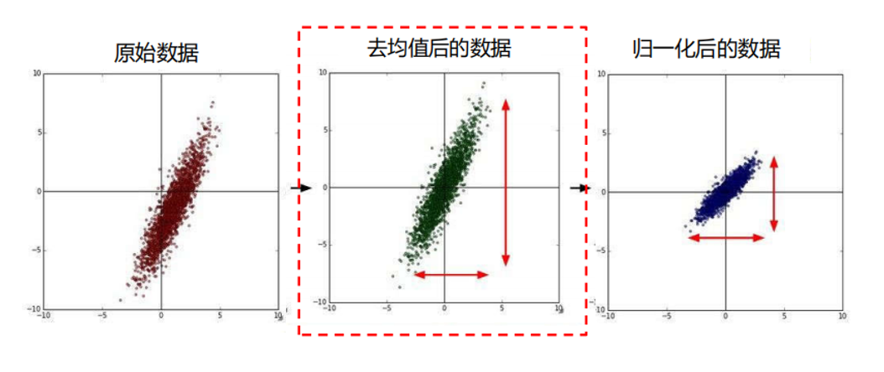
Raw Data
Mean Removal
Standardization

Slide 29
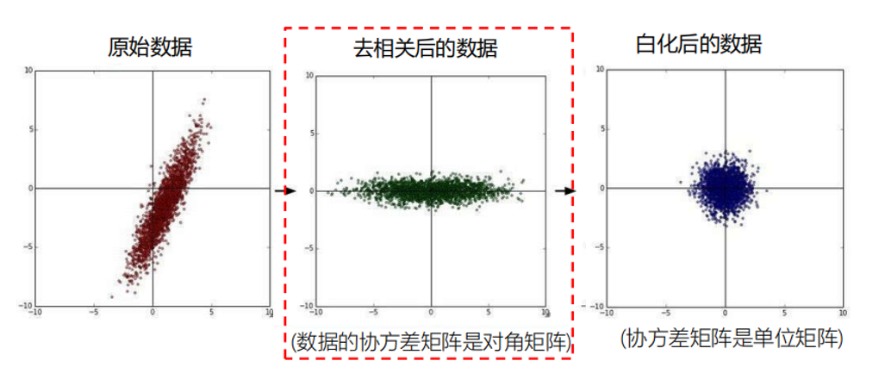
Raw Data
Decorrelation
Whitening
The covariance matrix of the data is a diagonal matrix.
The covariance matrix of the data is a identity matrix.

